Slide 1

Chapter 1
Introduction
1.<number>
Copyright © The McGraw-Hill Companies, Inc. Permission required for reproduction or display.
Notes:
1.#

Slide 2
1-1 DATA COMMUNICATIONS
The term telecommunication means communication at a distance. The word data refers to information presented in whatever form is agreed upon by the parties creating and using the data. Data communications are the exchange of data between two devices via some form of transmission medium such as a wire cable.
Topics discussed in this section:
Components
Data Representation
Data Flow
1.<number>
Notes:
1.#

Slide 3

Figure 1.1 Five components of data communication
1.<number>
Notes:
1.#

Slide 4
Data Representation
Text, numbers, images, audio, and video are different forms of Data Representation.
Text
In data communications, text is represented as a bit pattern, a sequence of bits.
Different sets of bit patterns have been designed to represent text symbols. Each set is called a code, and the process of representing symbols is called coding i.e ASCII made by ANSI, Unicode

Slide 5
Data Representation cont..
Numbers are also represented by using bit patterns. However , a code such as ASCII is not used to represent numbers; the numbers is directly converted to a binary number.
Images today are also represented by bit patterns but an image is divided in to a matrix of pixels.
Audio is a representation of sound. It is a continuous , not discrete.
Video can be produced either as a continuous entity or it can be a combination of images.

Slide 6

Figure 1.2 Data flow (simplex, half-duplex, and full-duplex)
1.<number>
Notes:
1.#

Slide 7
1-2 NETWORKS
A network is a set of devices (often referred to as nodes) connected by communication links. A node can be a computer, printer, or any other device capable of sending and/or receiving data generated by other nodes on the network.
Topics discussed in this section:
Distributed Processing
Network Criteria
Physical Structures
Network Models
Categories of Networks
Interconnection of Networks: Internetwork
1.<number>
Notes:
1.#

Slide 8
Network
A network is a set of devices (often referred to as nodes) connected by communication links.
Distributed Processing
  Most Networks use distributed processing, in which a task is divided among multiple computers

Slide 9
Network Criteria
A network must be able to meet a certain number of criteria. The most important of these are
Performance
Reliability
Security

Slide 10
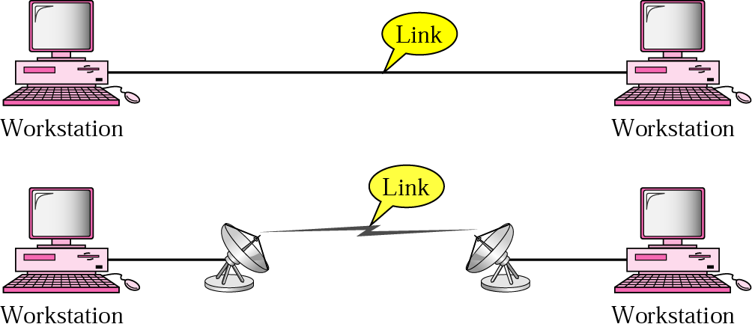
Physical Structures
Type of Connection
Physical Topology
Point-to-point connection

Slide 11
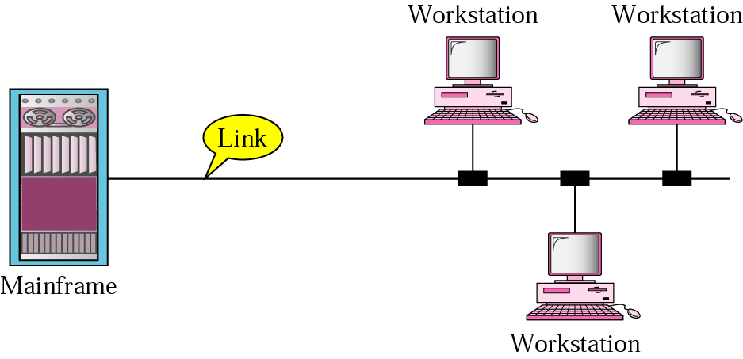
Physical Structures Cont..
Multipoint Connection

Slide 12
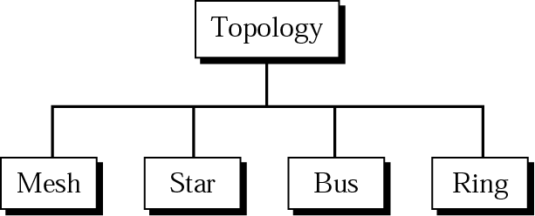
Physical topology
Topology refers to the physical or logical arrangement of a network.

Slide 13
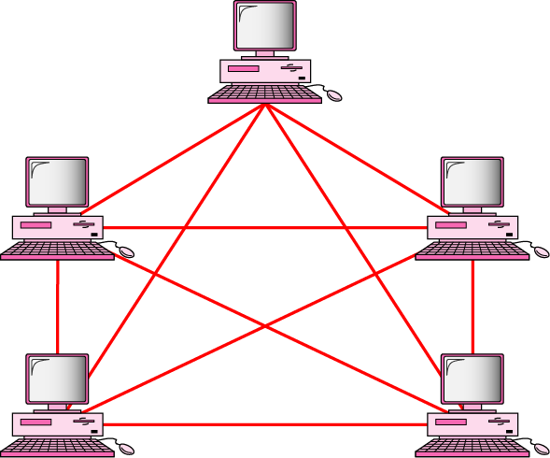
Mesh Topology
In a mesh topology, every device has a dedicated point to point link to every other device.

Slide 14
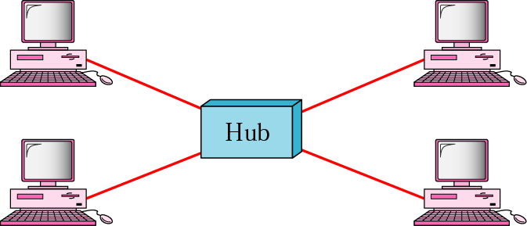
Star Topology
In a star topology, each device has a dedicated point to point link only to a central controller.

Slide 15
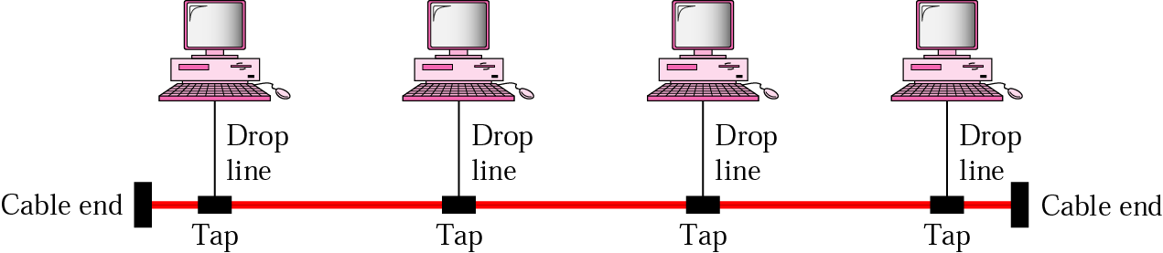
Bus Topology
A bus topology is a multipoint topology in which one long cable acts as a backbone to link all the devices in the network.

Slide 16
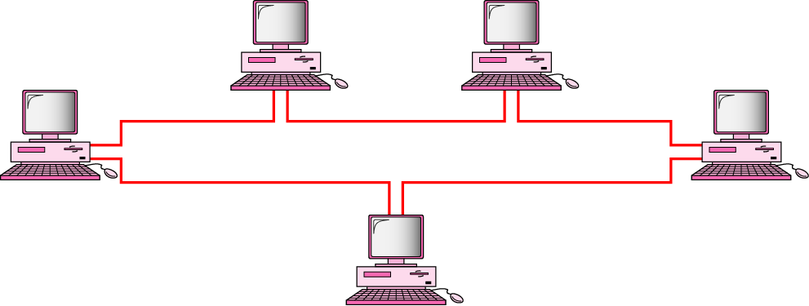
Ring topology
In a ring topology, each device has a dedicated point to point connection only with two devices on either side of it.

Slide 17
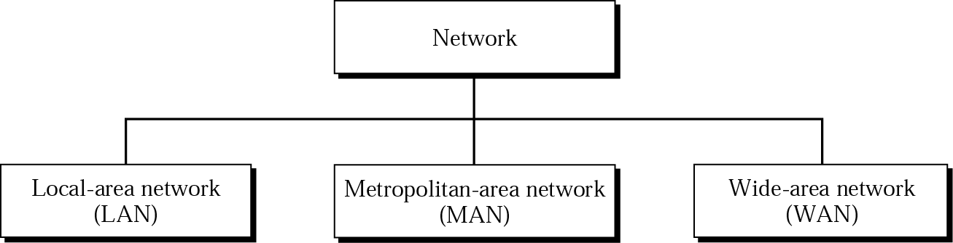
Categories of Networks

Slide 18
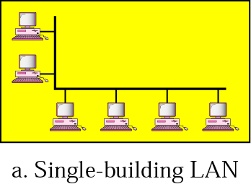
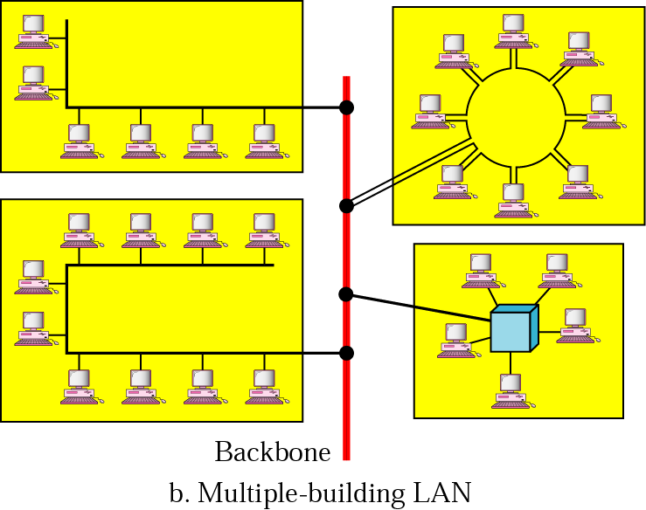
Local Area Network
A local area network is usually privately owned and links the devices in a single office, building, or campus.

Slide 19
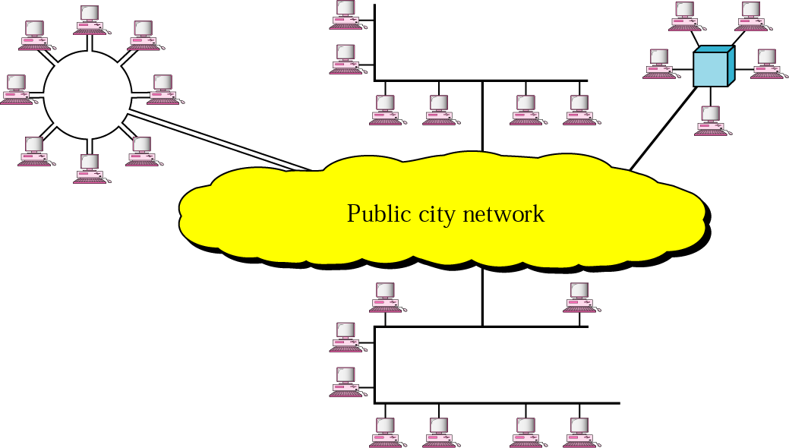
Metropolitan Area Network
A MAN is a data communication system covering an area the size of a town or city.

Slide 20
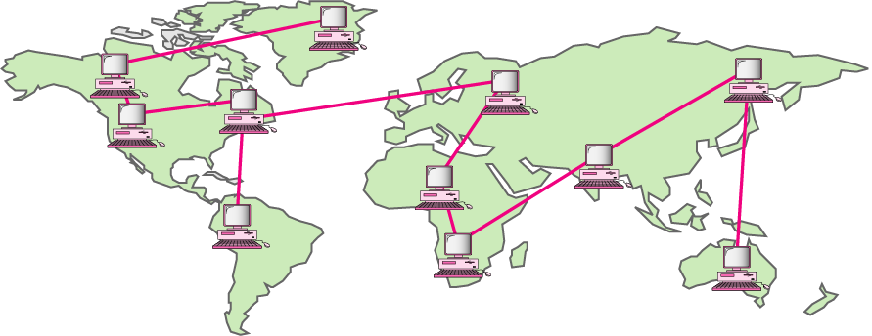
Wide Area Network
A WAN is a data communication system spanning states, countries, or the whole world.

Slide 21
WAN Implementation
Traditionally, WANs have been implemented using one of two technologies:
  Circuit Switching
  Packet Switching
Circuit Switching
In a circuit switching network, a dedicated communication path is established between two stations through the nodes of the network. Telephone network is a example of Circuit switching.
Packet Switching
In packet Switching it is not necessary to dedicate communication path between two stations. Data are sent out in a sequence of small chunks, called packets.

Slide 22
WAN Implementation cont…
Frame Relay
Frame Relay is also a packet switching technique with variable length packets develop to take the advantages of high data rates and low error rates of current Transmission Systems.
ATM
Asynchronous transfer mode, sometimes referred to as cell relay, is a culmination of developments in circuit switching and packet switching. ATM technology uses a fixed size packet called a cell.

Slide 23
Protocols and Standards
Protocol
A protocol is a set of rules that governs data communication;
The key elements of a protocol are Syntax, Semantics and Timing.
Syntax
Syntax refers to the structure or format of the data. For example, a simple protocol might expect the first 8 bits of data to be the address of the sender, the second 8 bits to be the address of the receiver, and the rest of the stream to the message itself.
Semantics
Semantics refers to the meaning of each section of bits. For example, does an address identify the route to be taken or the final destination of the message?
Timing
Timing refers to two characteristics: when data should be sent and how fast they can be sent.

Slide 24
Protocols and Standards
Standards
Standards are necessary to ensure that products from different manufactures can work together as expected.
Data communication Standards fall in to two categories: de facto and de jure
De facto
Meaning by fact, standards that have not been approved by an organized body but have been adopted as standards through widespread, Often established originally by manufactures that seek to define the functionality of a new product or technology.
De jure
Those that have been legislated by an officially recognized body.

Slide 25
Standards Organizations
International Organization for Standardization (ISO)
International Telecommunication Union-Telecommunication Standards (ITU-T)
American National Standards Institute (ANSI)
Institute of Electrical and Electronics Engineers (IEEE)
Electronic Industries Association (EIA)

